Slide 1
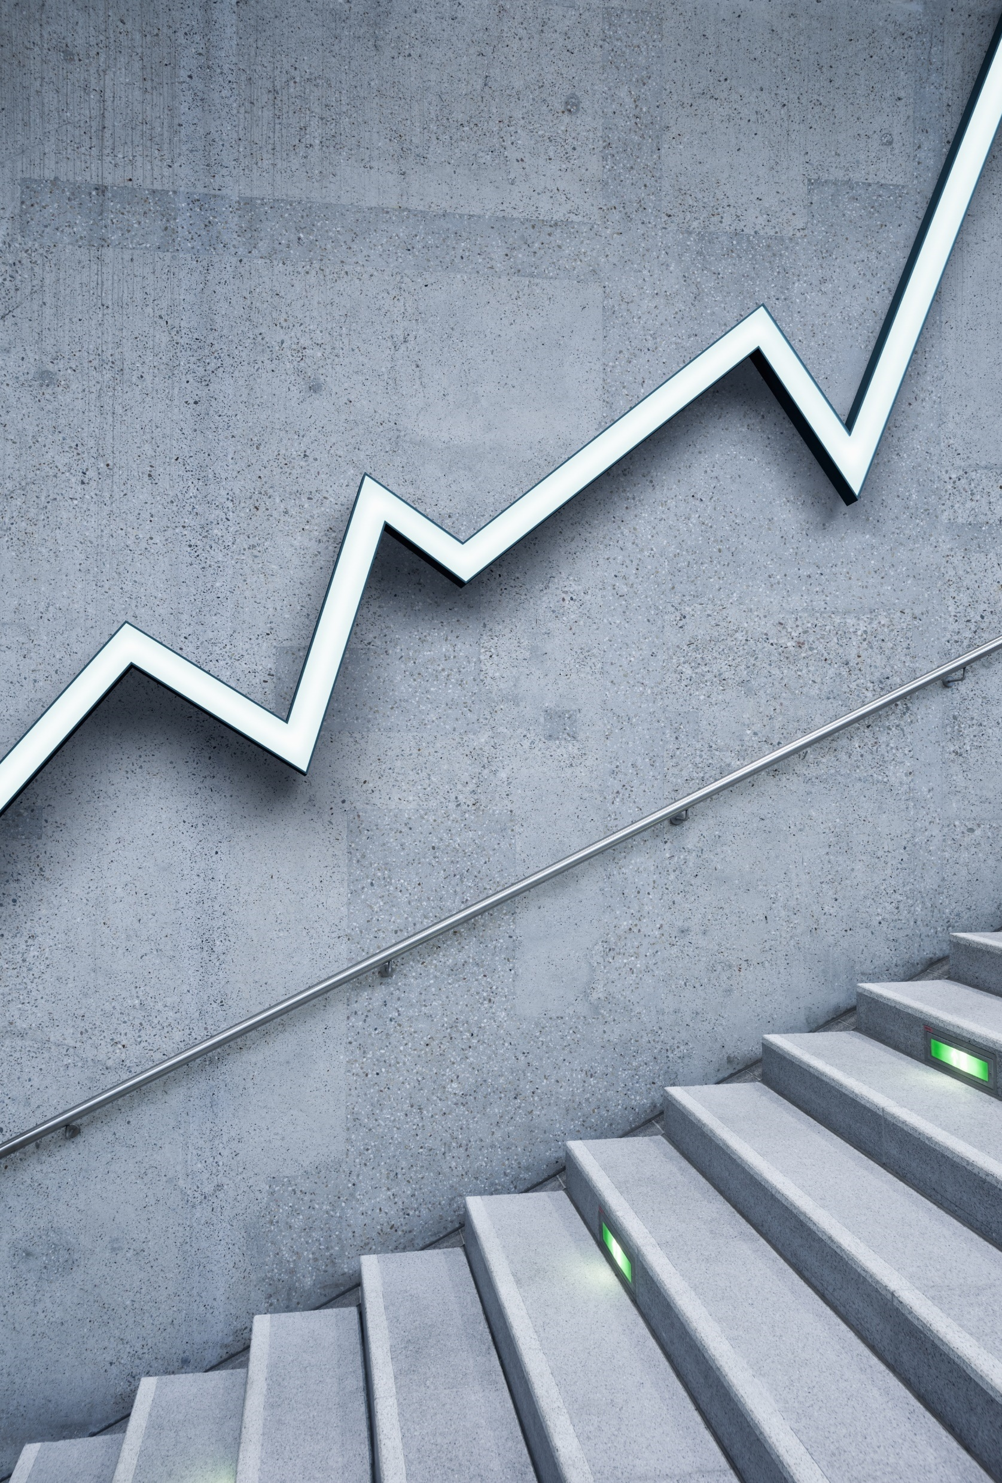
Capital Asset Pricing Model
GROUP 24

Slide 2
INTRODUCTION
The Capital Asset Pricing Model (CAPM) is a financial framework that quantifies the relationship between the expected return of an asset, the risk-free rate, and its systematic risk, often measured by beta. CAPM provides a systematic approach to evaluating the expected returns of assets within a well-diversified portfolio, making it a widely used tool in financial analysis and portfolio management.
The primary objective of this project is to construct an optimal investment portfolio by integrating a risk-free asset and a diversified selection of risky assets. Through the application of the CAPM, we seek to estimate the expected returns for the risky assets, forming the basis for the Capital Market Line (CML).

Slide 3
ASSETS
BTC USD (Bitcoin - USD): Bitcoin is a decentralized digital currency, known for its limited supply and decentralized blockchain technology. It is a popular cryptocurrency and a store of value.
IDEA.NS (Vodafone Idea Limited): Vodafone Idea Limited is a telecom company in India, providing services such as mobile telephony, wireless broadband, and enterprise services.
MATIC-INR (Polygon - INR): Polygon (MATIC) is a blockchain scalability platform that aims to enhance the performance and usability of decentralized applications (DApps) on the Ethereum network.
MINDACORP.NS (Minda Corporation Limited): Minda Corporation Limited is an Indian company engaged in the manufacturing of automobile components, including safety and security systems.
MRNA (Moderna Inc.): Moderna Inc. is a biotechnology company known for its development of mRNA-based vaccines, including the COVID-19 vaccine.

Slide 4
PIDILITIND.NS (Pidilite Industries Limited): Pidilite Industries Limited is an Indian company involved in the manufacturing and marketing of adhesives, sealants, and construction chemicals.
QQQ (Invesco QQQ Trust): The Invesco QQQ Trust is an ETF that tracks the performance of the Nasdaq-100 Index, composed non-financial companies listed on the Nasdaq Stock Market.
SPY (SPDR S&P 500 ETF Trust): SPDR S&P 500 ETF Trust is an ETF that aims to track the performance of the S&P 500 index, representing a broad range of large-cap U.S. stocks.
TSLA (Tesla Inc.): Tesla Inc. is an American electric vehicle and clean energy company known for its electric cars, energy storage solutions, and solar products
Apple Inc. (AAPL): Apple Inc. is a leading American technology company celebrated for its revolutionary consumer electronics and software, including iconic products like the iPhone and Mac.
Amazon.com Inc. (AMZN): Amazon.com Inc. is a global e-commerce and technology giant recognized for its extensive range of services.

Slide 5
CAPM
The CAPM formula is: Expected return of the investment = the risk-free rate + the beta (or risk) of the investment * the expected return on the market - the risk free rate
The weights for the tangency portfolio are calculated using the Capital Asset Pricing Model (CAPM) formula.
CML is a straight line that connects the risk-free rate of return to the optimal portfolio of risky assets, where the portfolio's expected return is maximized for a given level of risk.
E(Rp) = Rf + [Rm - Rf] x (σp/σm).

Slide 6
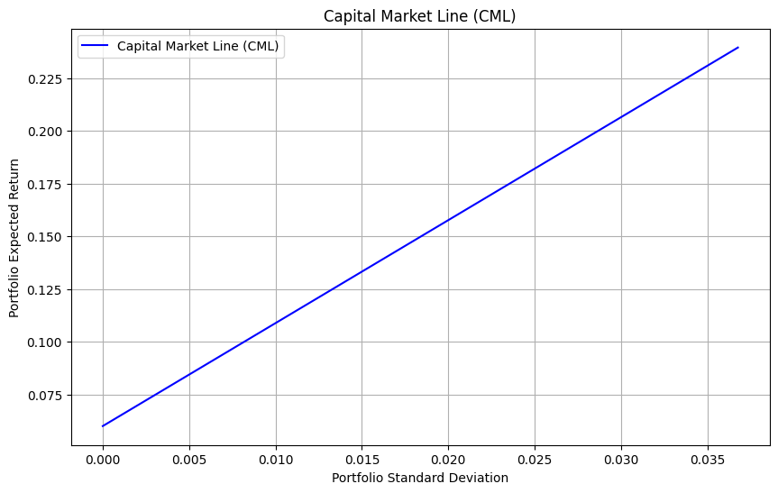
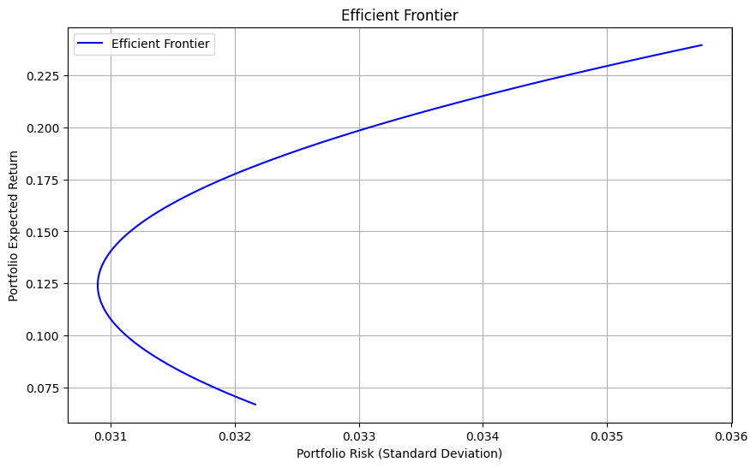
The Capital Market Line (CML) represents the optimal risk-return trade-off available to investors. It depicts combinations of the risk-free asset and the market portfolio that maximize return for any given level of risk.
The Tangency Point on the Efficient Frontier signifies the pinnacle of optimal risk-return tradeoff in portfolio management. It marks the intersection where portfolios achieve the highest return for a chosen level of risk, guiding investors in constructing well-balanced portfolios.

Slide 7
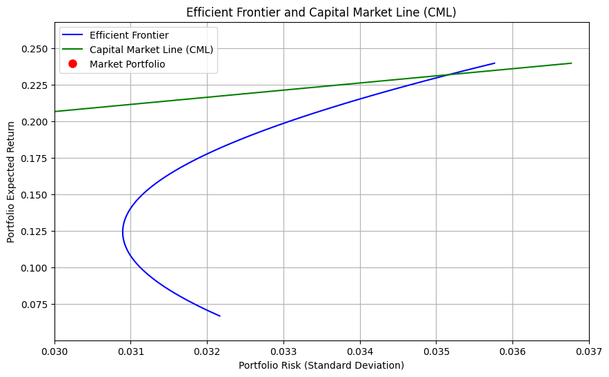
TANGENCY POINT

Slide 8
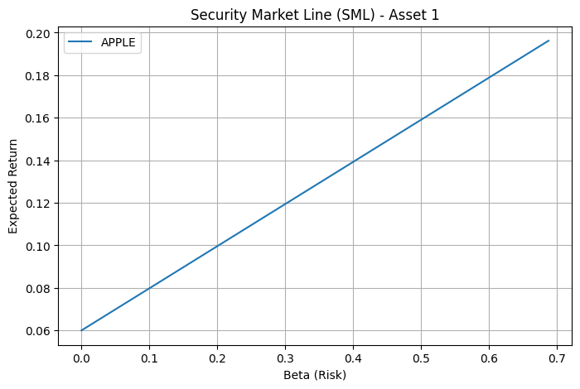
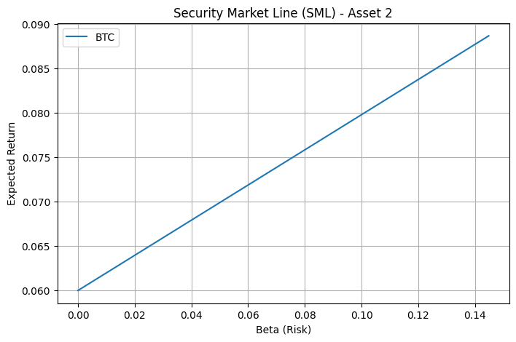
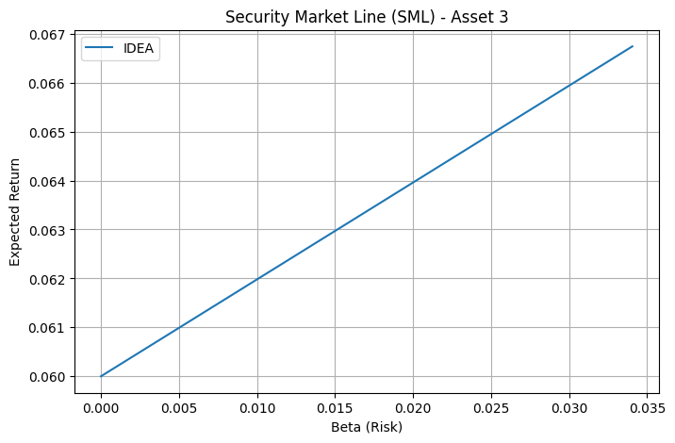
SECURITY MARKET LINES
Individual Security Market Lines (SML) represent the relationship between an asset's expected return and its systematic risk. Calculated using the Capital Asset Pricing Model (CAPM), SML helps assess the risk-return profile of specific assets within the broader market context.

Slide 9
SHARPE AND TREYNOR RATIOS
The Sharpe ratio of the tangency portfolio is calculated using the formula. Sharpe Ratio = Mean Return − Rf / Standard Deviation
The Treynor ratio of the market portfolio is calculated using the formula. Treynor Ratio=Mean Return − Rf / Beta
The points for the Capital Market Line (CML) are calculated using the Sharpe ratio and the efficient frontier by applying the CML equation for different levels of portfolio standard deviation.
The tangency point (market portfolio) is identified by finding the point on the efficient frontier that is closest to the CML. This point represents the optimal portfolio with the highest Sharpe ratio.

Slide 10
PERFORMANCE MEASURES
When comparing the relevant performance measures of optimized portfolios with individual assets, the Sharpe Ratio provides a valuable insight into risk-adjusted returns. Optimized portfolios tend to exhibit higher Sharpe Ratios, indicating superior risk-adjusted performance compared to individual assets, as they strike a more efficient balance between risk and return.
Similarly, the Treynor Ratio, which considers systematic risk, reveals how well an asset or portfolio compensates investors for market risk. Optimized portfolios often showcase higher Treynor Ratios, reflecting their ability to generate greater returns per unit of systematic risk when compared to individual assets.

Slide 11
KEY INSIGHTS
MARKOWITZ APPROACH
CAPM APPROACH
Emphasizes diversification to minimize overall portfolio risk.
Considers covariance among assets to achieve an efficient frontier.
Focuses on constructing portfolios that balance risk and return.
Incorporates the risk-free rate and market risk to determine an asset's expected return.
Aids in understanding the relationship between an asset's risk and expected return within the broader market context.
Provides insights into asset pricing and risk-adjusted returns.

Slide 12
THANK YOU
RAHUL KOVIDH
MANIHAS DHYAN

